Slide 1
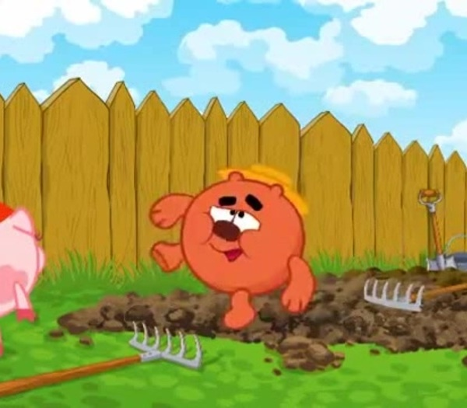
GraBLEE
Graph rendering and
better layout extensive environment
Milana Vorobeva
Aleksandr Ershov
Affiliation: ITMO
Scientific adviser: Trifanov A.I., Ph.D., Associate Professor, REC Mathematics
Adviser: Senior researcher Danil Sagunov
Under JCP of Graph Algorithm team STIL SRC RRI
2024
Notes:
Нарисовать граф, где вершины – это маленькие копатычи

Slide 2
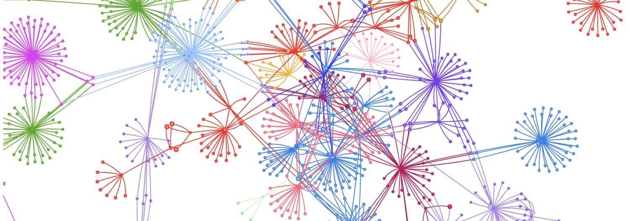
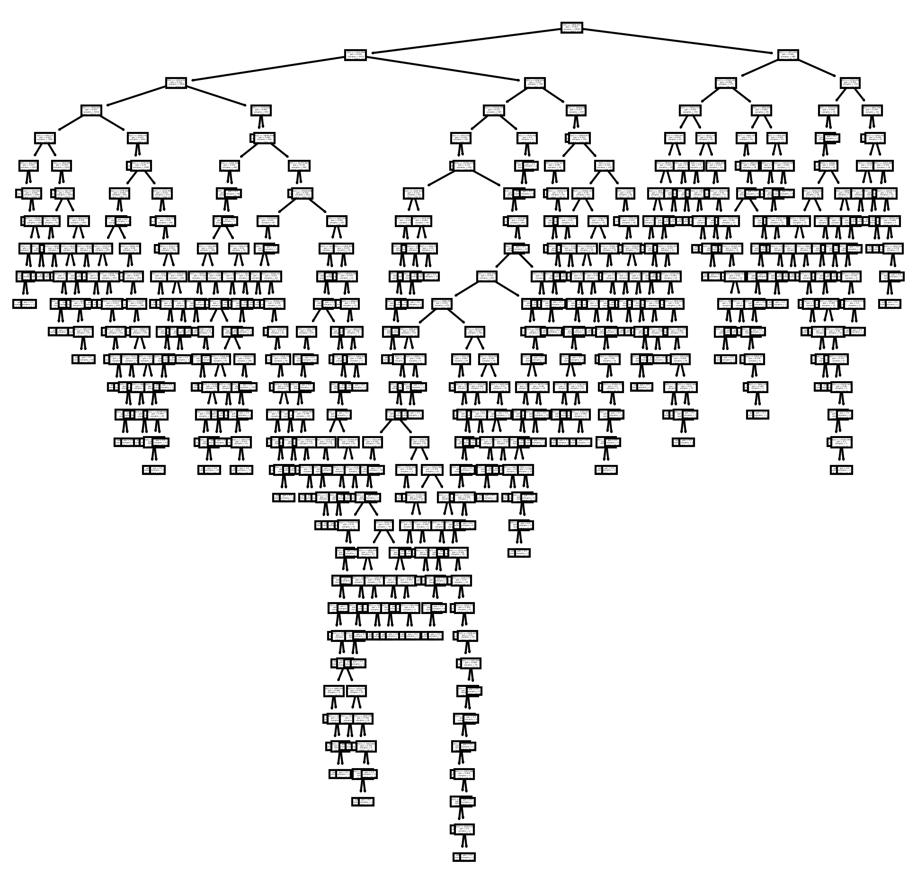
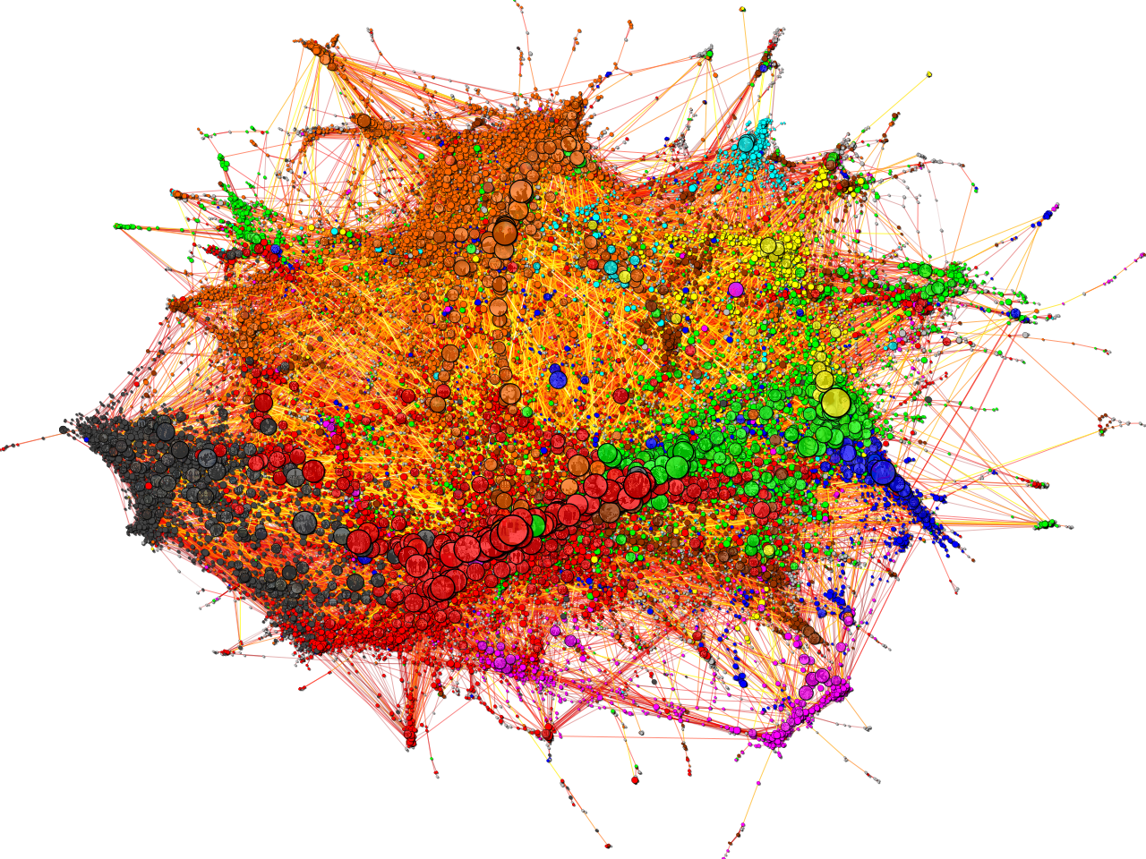
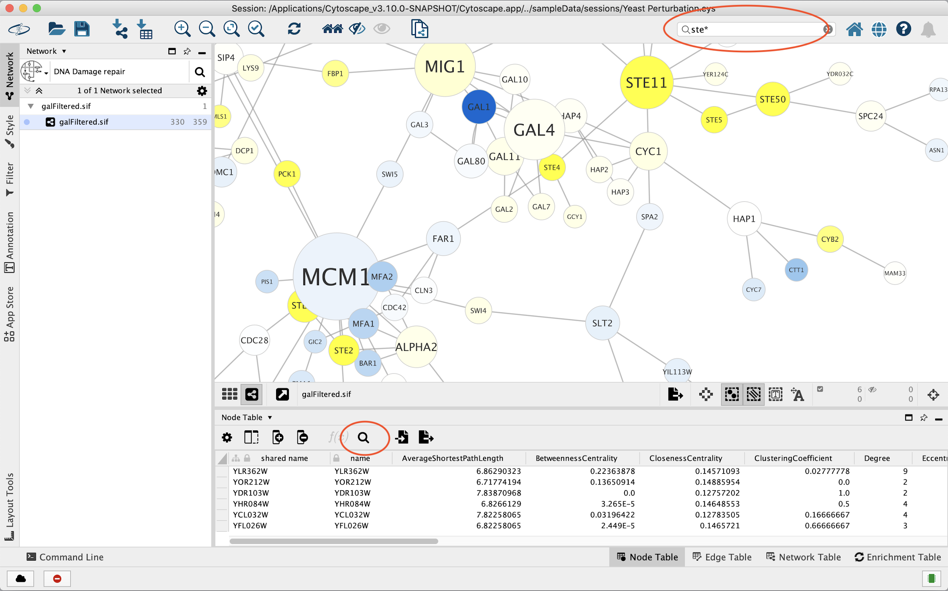
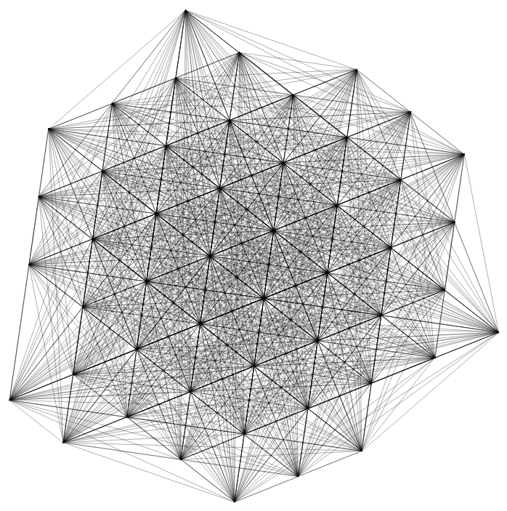
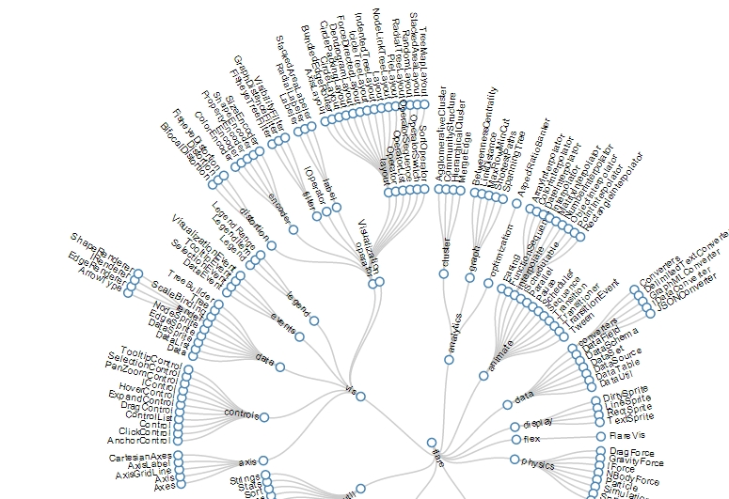
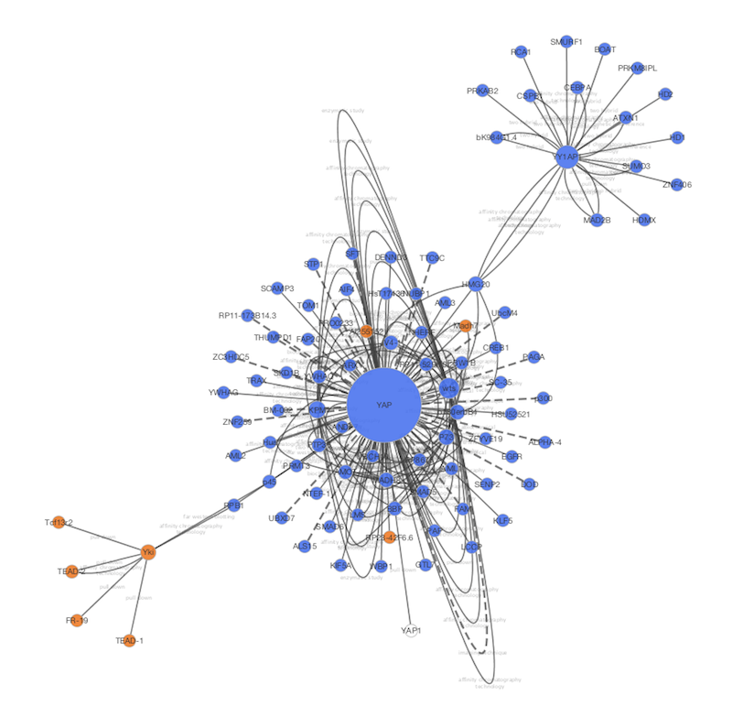
Issue #1
Issue #2
When working with graphs, it is essential to visualize them regularly, as the empirical research method often significantly accelerates problem-solving.
Visualized graph data should be presented to the user in the most convenient manner, ensuring that the data is representative and does not require pre-configuration.

Slide 3

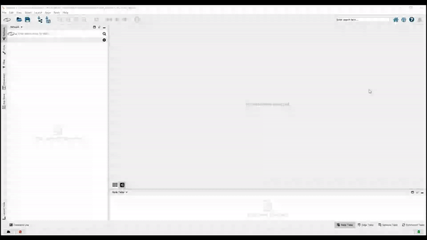

Issue #1
Create visual graph data
Currently, GA-team are manually using Cytoscape, which requires a significant amount of time and effort to configure styles and layouts.
You can see that the current process of obtaining representative visual graph data in Cytoscape requires a huge number of clicks!
It is little graph. Usually graph contains around 1 000 000 vertices
This little maneuver is gonna cost us 51 years

Slide 4


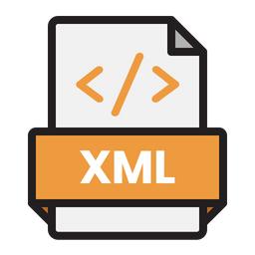




Issue #2
Sharing visual graph data
1. Apply layout manually
2. Export graph data file (f.e. GML, cyjs) from Cytoscape
3. Set styles parameters and export XML styles file from Cytoscape
Option #1 Send a package of files
User don’t want configure files!!!
Option #2 Create and send Cytoscape session file, which contains all visual data
The best option!!!

Slide 5
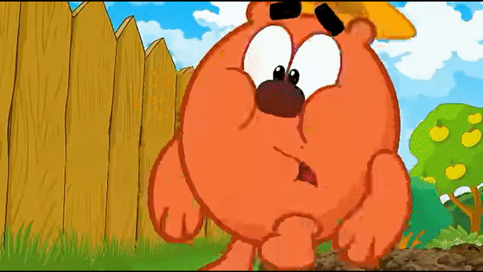
And each time the creation of the necessary visualization tool was sacrificed to save time, but in the end, more time was actually spent, stepping on the same rake.
Experience has shown that a convenient and effective visualization tool is indispensable in every graph problem or project!

Slide 6

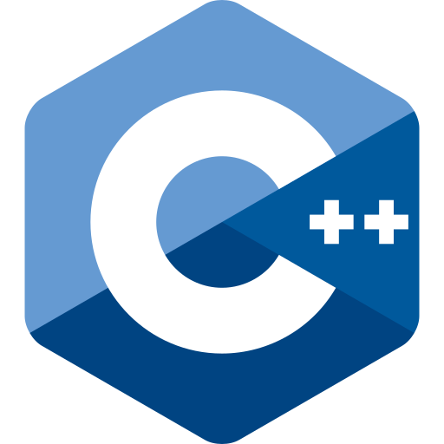

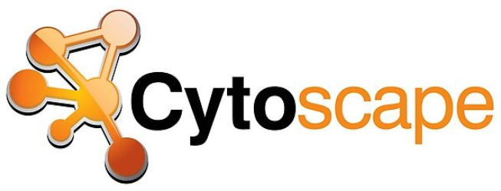

Proposed solution
We’ve created an application GraBLEE that is a Python wrapper which fast and easy does all the dirty and routine work of visualizing the graph.
This is achieved by automated work with:

Slide 7




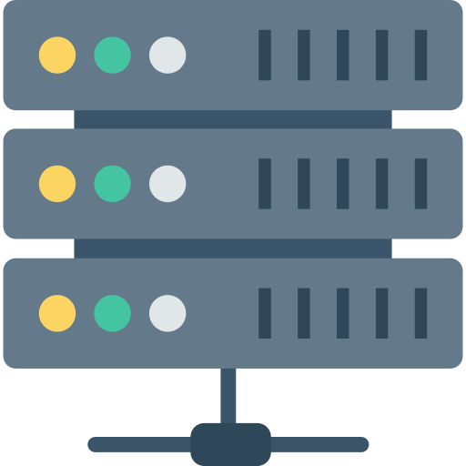

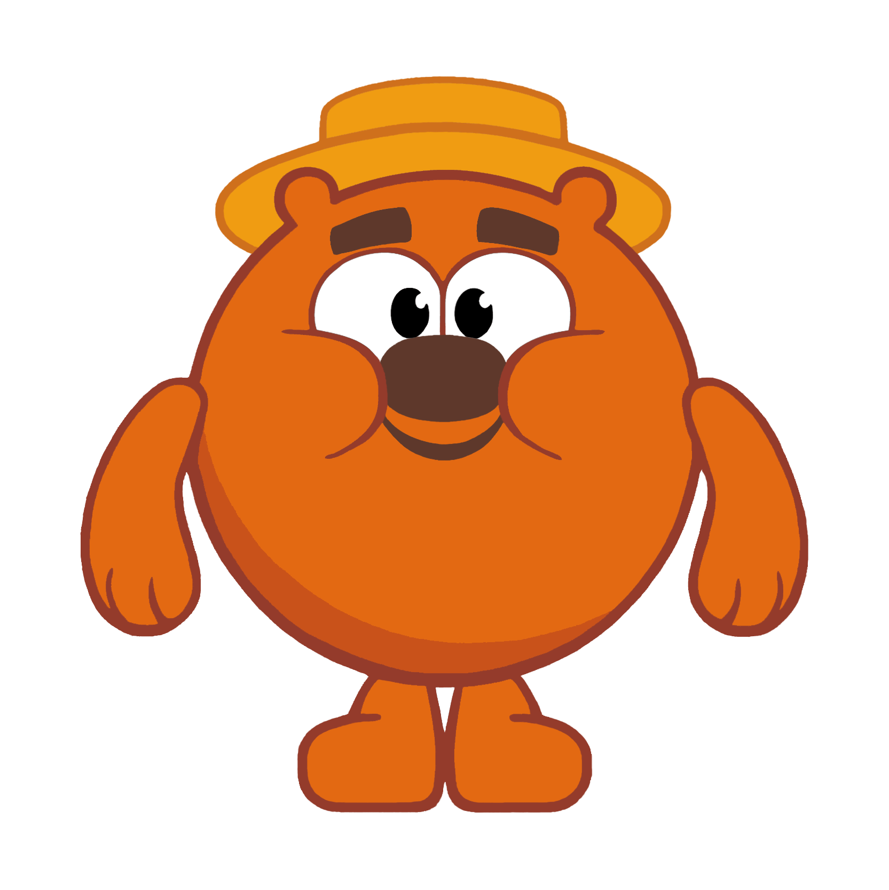
How does it work?
GraBLEE client
user
GraBLEE server with running cytoscape

Slide 8
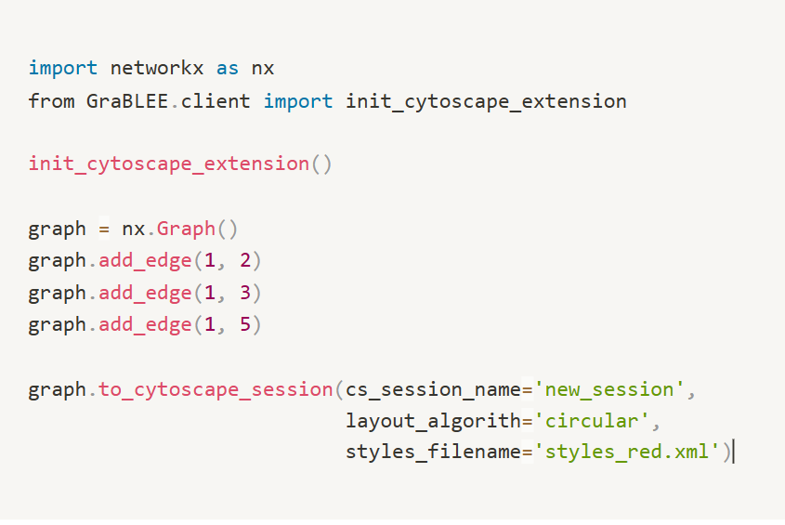

How to use it?
With the wrapper, users only need to invoke two methods to obtain a fully completed Cytoscape session file.
We define the process of obtaining a session as an extension of the networkx.Graph class.
1. Set layout parameter
2. Choose styles
Ready!

Slide 9

You can compare how much faster and easier it has become to get quality graph visualization!

Slide 10


Analogues
There are no analogs that meet all the requirements of the team. As an analog option - Cytoscape itself, which is inconvenient for the reasons stated.
GraBLEE is designed to work with large graphs. We use optimized instruments and can provide flexible styles customization

Slide 11
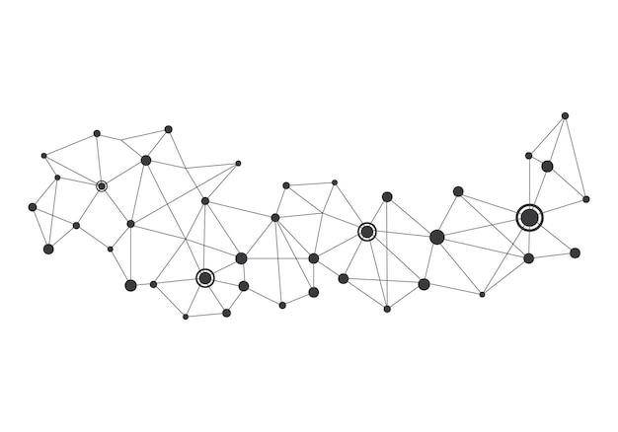
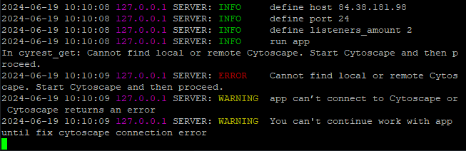
Advantages
GraBLEE provide work with large graph that contains a few hundreds nodes
Convenient presentation of logs, which allows you to easily determine what went wrong

Slide 12


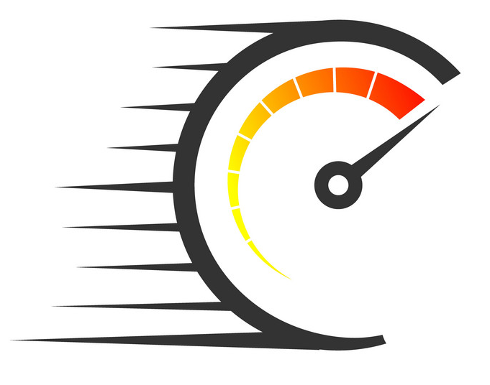
Advantages
Stable operations in multi-user mode
Availability of detailed user-friendly manual
High data transfer speed over the network

Slide 13


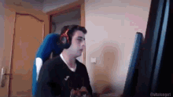
Conclusion
As a result, you get on your device a fully completed cytoscape session file, which contains representative and does not require pre-configuration graph visual data
You can immediately open session in Cytoscape or send it to user
With propoesd solution user spends around 10 seconds on manual work
Instead of 2-3 minutes every time after every processing step, which spends manually work

Slide 14

Thank you for your attention!

Slide 15


